Slide 1
Building a Data Processing Pipeline Using Spark
Dhruv Nain,Tianfan Yang,Shuhao Ruan
Github Repo: Wildlife_pipeline_Spark
05/08/24

Slide 2
PROBLEM FORMULATION
P A R T 0 1

Slide 3

Objective
The ultimate goal is to demonstrate Spark’s capabilities in processing large datasets effectively and to compare performance improvements over the existing setup.
.
Specific Aim
Apache Spark Integration
Information Extraction Improvements
Data filtering
Challenges
Scalability and Performance
Data quality and Completeness

Slide 4
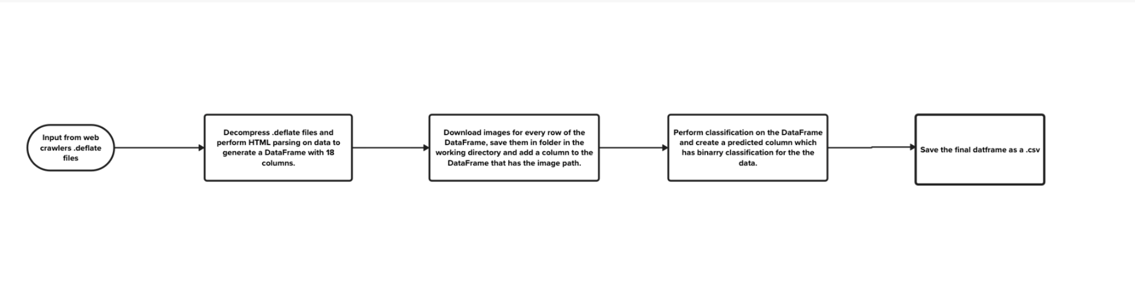
Background

Slide 5
Architecture
and
Design
P A R T 0 2

Slide 6
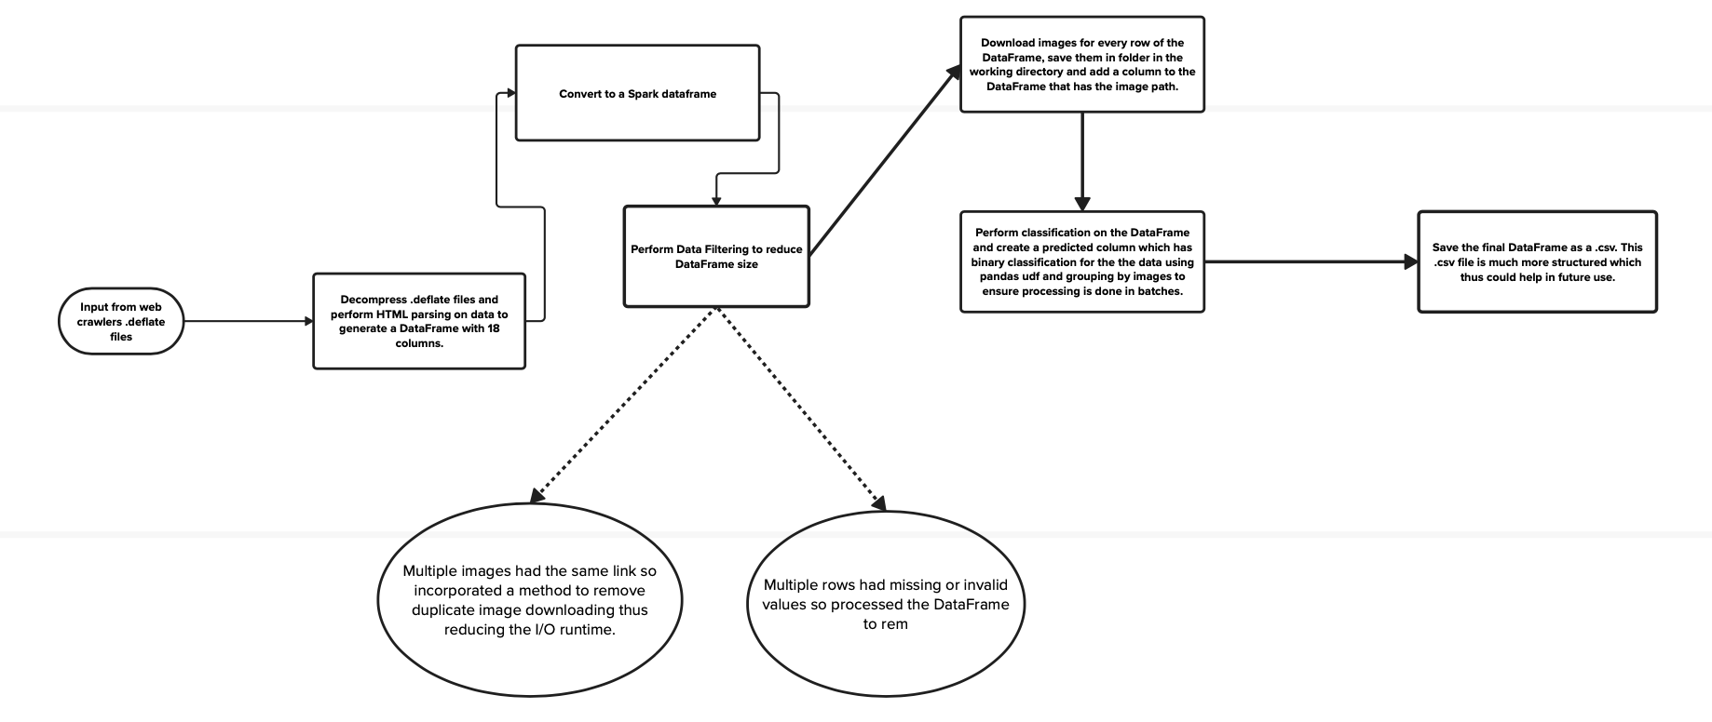
Pipeline Architecture

Slide 7
Approach for Duplicate image handling
Filter the DataFrame to exclude rows where the ”image path” column is null or doesn’t contain valid values.
A unique identifier (unique id) is added to the DataFrame using the monotonically increasing id() function. This identifier helps manage duplicates and facilitate rejoining after deduplication.
Duplicate image URLs are removed from the DataFrame using the dropDuplicates(["image"]) method. The first unique ID associated with each unique image URL is retained.
The download and save image User-Defined Function (UDF) is applied to download and save images for unique URLs. The UDF checks if an image already exists in the specified image folder. If it does not exist, the image is downloaded from the URL and saved with a unique identifier (image id) as its filename.
The image paths (image path) corresponding to each unique image URL are joined back to the original DataFrame (df) using a left outer join. The join is performed based on matching image URLs between the original DataFrame and the image DataFrame (image df).

Slide 8
Tuning the image classification process
All columns in the DataFrame are converted to strings using the col(column name).cast("string") operation. This step ensures consistent data types for further processing.
A specific schema (ad schema) is defined for the DataFrame to ensure data consistency and enforce column types.
A Pandas User-Defined Function (UDF) named convert to pandas is defined using pandas udf with the GROUPED MAP type. This UDF takes a grouped DataFrame as input and performs inference and classification operations on it.
Inside the UDF, it retrieves inference data using the get inference data function, then runs inference using the loaded classifier (classifier) and the retrieved data. The inferred predictions are added to a new column named ”predicted label” in the DataFrame.

Slide 9
Results
P A R T 0 3

Slide 10
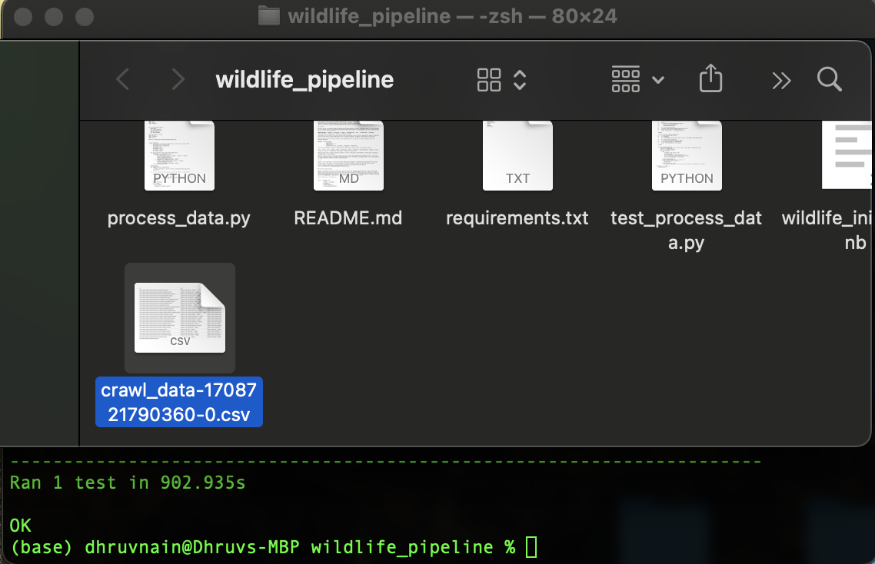
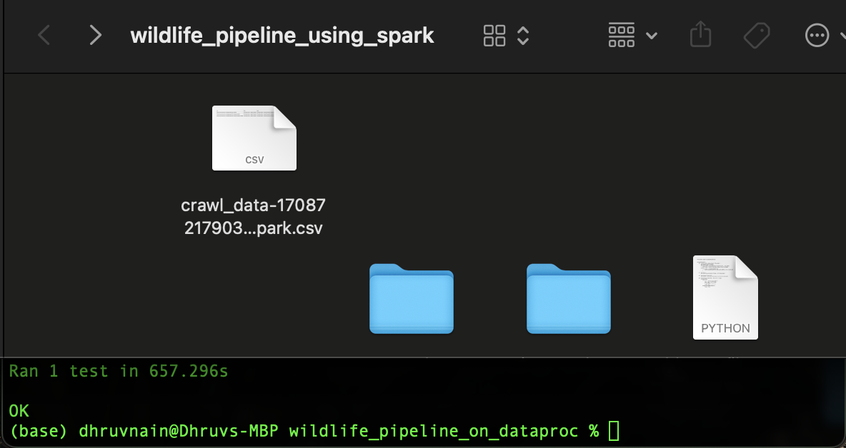
Pandas Pipeline
Spark Pipeline

Slide 11
Thank You

